Slide 1
NEO4J CYPHER TUTORIAL WITH PYTHON
Create Multiple Nodes In Neo4j Graph Using Apoc Procedure & Python
Tutorial 96

Slide 2
Use case
Create Multiple Nodes In Neo4j Graph Using Apoc Procedure & Python

Slide 3
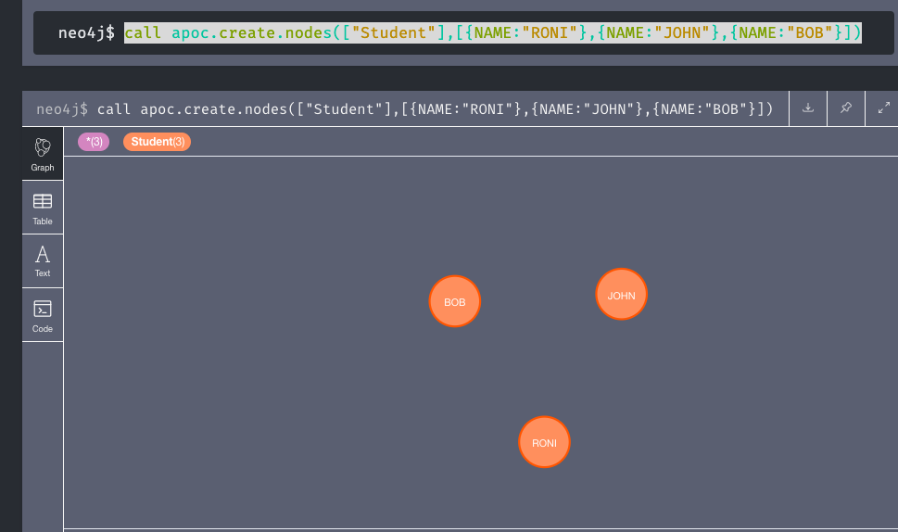
Create Multiple Nodes In Neo4j Graph Using Apoc Procedure & Python
Code written in neo4j browser

Slide 4
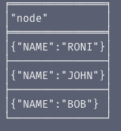
output
From neo4j browser

Slide 5
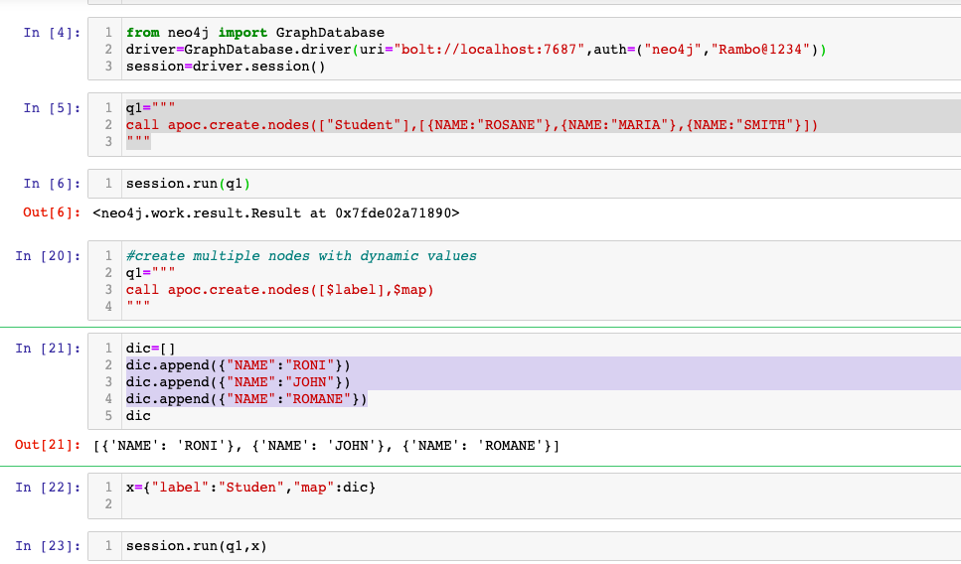
Create Node In Neo4j Graph Using Apoc Procedure & Python
Code written in python ide

Slide 6
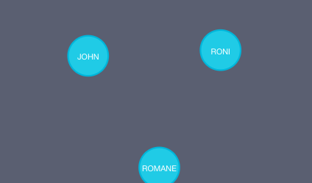
output
From python ide

